Slide 1
Resume → Real-Time Job Matching on HF
Liming Ye, Yuang Li, Yiran Tao, Renke Deng, Siyu Hu

Slide 2

Motivation
Job seekers often miss relevant opportunities because job titles and skills are described inconsistently, keyword search is unreliable, and resumes/JDs are unstructured or hard to parse. At the same time, job postings update rapidly. Our goal is to provide a real-time, semantically meaningful matching system that reliably extracts resume content and retrieves the most relevant recent roles with clear explanations.
Notes:
So, all of us are second-year master’s students, and we’re right in the middle of stressful job hunting. just like everyone else, we often miss good opportunities — not because we’re not qualified, but because the job market is messy.
Like Job titles mean different things at different companies, descriptions can be all over the place, and keyword search doesn’t really understand what a person can actually do.
So our goal is pretty simple: we want a system that can actually understand a resume and surface relevant jobs.

Slide 3

System at a Glance
What the system does
You upload a resume, and the system automatically understands your skills and experience.
It gathers real-time job postings from major platforms.
It compares your background with thousands of roles-not with keywords, but with meaning.
It returns the most relevant and recent opportunities, along with an explanation of why they match.
Why this matters
Job seekers often miss good roles because titles vary and keywords fail.
Our system aims to reduce that gap by offering semantic, timely, and transparent job recommendations.
Notes:
This is the high-level idea before we dive into details.
So You upload a resume, the system reads it and figures out your skills and background.
At the same time, we fetch real-time job posts from public platforms.
Then we compare your profile with thousands of roles—not by matching keywords, but by understanding the meaning behind the text.
Finally, we return the most relevant and recent jobs

Slide 4
Final Goals
Core System Deliverables
Guaranteed Features
Real-time job crawling from multiple platforms
TF-IDF similarity (Top-10)
Clear explanations: matched skills, similarity, summaries
Deployed on Hugging Face with filters
Notes:
For the final system, we keep our goals clear and focused.
We want the platform to pull fresh jobs on its own, understand resumes well enough to rank opportunities meaningfully, and explain why each job shows up.
And most importantly, everything runs live on Hugging Face with the basic filters people actually use ，like state， remote, and recency.

Slide 5
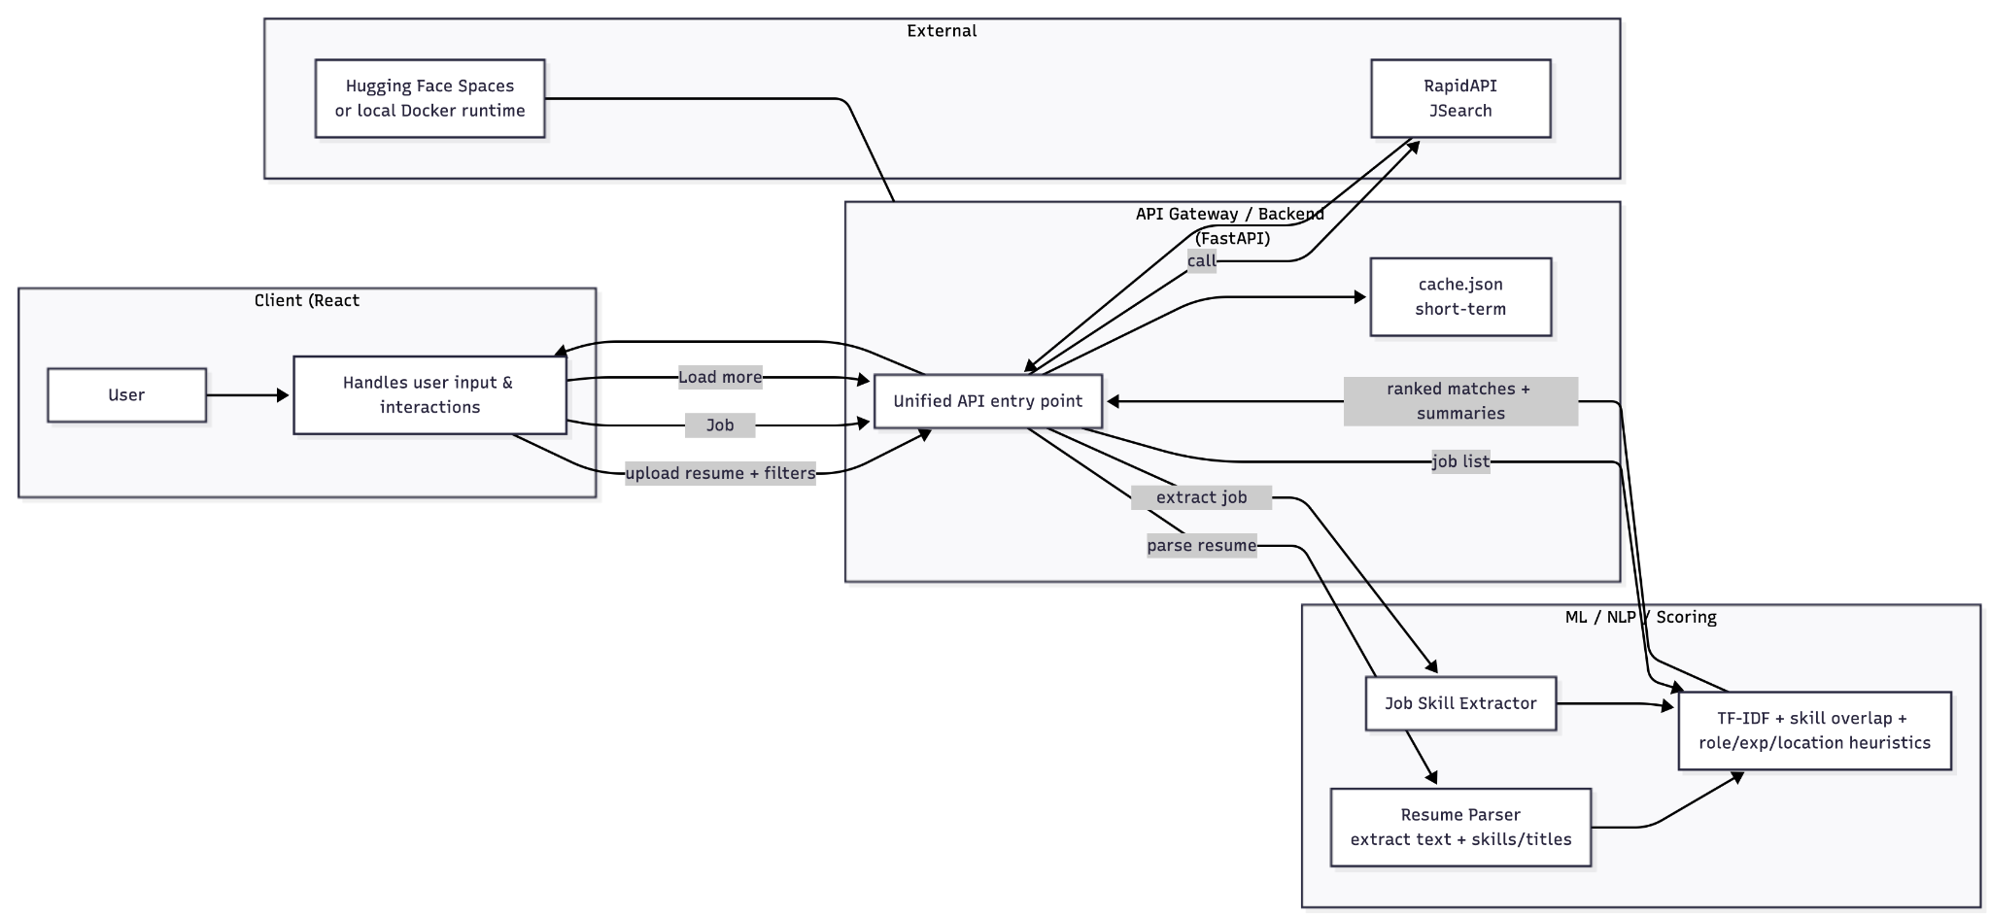
System Overview
Notes:
Here’s a quick walkthrough of how the whole system works end-to-end.
Everything starts from the user on the front end. They open the page, upload a resume, adjust filters, and the React app sends everything to a unified backend API.
Once the request reaches the API gateway, the backend decides what needs to happen. If we don’t have fresh job data, we call the external job API through RapidAPI, and cache the results.
At the same time, the resume goes into our NLP/ML service. It parses the text, identifies key sections, and extracts skills using our dictionary and alias rules. We apply the same skill-extraction logic to every job post so resumes and jobs share the same structured format.
Both sides then enter our scoring module, which blends TF-IDF similarity, skill overlap, role alignment, experience level, and location signals to produce a final ranked list.
The backend returns the top results along with brief explanations— like matched skills, semantic similarity, and a short job summary. Finally, the front end displays everything in a simple feed where users can load more results or update filters without re-uploading their resume.

Slide 6
Data Sources & Preprocessing
Real-time job postings
Job data is fetched using the RapidAPI JSearch API
No direct web crawling is performed
Basic JSON-based caching is used to reduce repeated API calls
Resume preprocessing
Text extraction using pdfplumber
Rule-based section detection (Skills / Experience / Education)
Notes:
Now let’s take a closer look at where our data comes from and how we prepare it.
For job postings, we use the RapidAPI and JSearch API. That means all the data comes through a stable public endpoint, and we avoid any scraping issues. We also keep a small JSON cache on the backend so repeated searches don’t keep hitting the API.
On the resume side, we start by extracting text with pdfplumber. Once we have the raw text, we run some simple rule-based logic to find key sections like Skills, Experience, and Education. This gives us a much cleaner structure to work with before we move on to parsing, matching, and scoring.”

Slide 7
Frontend Overview
Tech Stack
Role in the System
User Interaction
Upload resumes (PDF / DOCX)
Filters: state /experience
View Top-10 recommended jobs with similarity scores
Inspect score, matched skills and job summaries
Apply by an external application link
React + TypeScript + Vite for a lightweight, fast development experience
Component-based UI for clean structure
Centralized apiClient and REST API integration
Fully deployed inside Hugging Face Spaces (through Docker)
All user interactions
Collects, validates inputs and send requests to backend
Rendering parsed text and job recommendations
Presentation layer for ML pipeline
Notes:
Hi everyone — I’ll give a quick overview of the frontend and its role in our job recommendation system.
When users enter the webiste, they can upload a PDF or DOCX resume, enter a job title, location and years of experience. Once they click Submit, the frontend will packages all inputs and sends them to the FastAPI through the endpoint.
Then, the results page will return the Top-10 recommended jobs. Each job card includes a similarity score, a short summary, and matched skill tags. Users can open any card to view details and the application link. And they can click “Load More” to see more results
So our tech stack, React + TypeScript + Vite, it is a lightweight development setup. Our UI is fully component-based— like JobCard and JobDetailCard . all communication with the backend is handled through a single apiClient. This allows the entire system to be deployed on Hugging Face Spaces through Docker with minimal configuration.
To summarize: the frontend handles all user interaction, collects and validates inputs, drives the rendering of recommended jobs, and ensures a smooth experience. It serves as the presentation layer for the backend ML pipeline and job-matching engine.

Slide 8
Backend Overview
Tech Stack
Role in the System
Core Responsibilities
Parse PDF/DOCX resumes
Extract structured fields: Summary / Skills / Experience
Fetch real-time jobs via RapidAPI JSearch
Apply ML Model
Return Top-10 results
FastAPI for lightweight, high-speed API service
Pdfplumber / python-docx parsers
JSearch API integration
Local cache (cache.json)
Connects frontend inputs to recommendation engine
Coordinates parsing, job retrieval, and scoring
Supports personalized job recommendations
Notes:
On the backend, we built a lightweight FastAPI service that connects the frontend inputs to the entire recommendation system.
When a file is uploaded, the backend first passes it to our ResumeParser, The parser converts the resume into clean text and splits it into structured sections such as Summary, Skills, and Experience.
And then it will call the JobSearch API to fetch real-time job postings that match the user’s target role and location. These job postings, together with the parsed resume sections, enter our maching learning pipeline which will be discussed later.
After the maching learning modeling, the backend returns the Top-10 ranked jobs, while the complete job list is written to a cache file so you can click load more to see more recommendations.
Overall, the backend is responsible for resume parsing, integrate external API, and personalized scoring. And it support the full recommendation workflow.

Slide 9
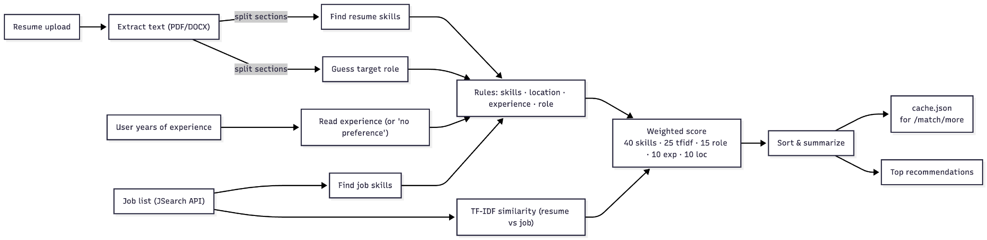
NLP Pipeline
Notes:
"Let me walk you through our NLP pipeline." The process starts when a user uploads their resume — we support both PDF and DOCX formats. Our parser extracts the raw text and splits it into sections like Skills, Experience, and Education. From the resume, we do two things in parallel: first, we extract the candidate's skills using a dictionary-based matcher; second, we infer their target role based on both the resume content and the job title they entered. We also read the user's years of experience from the form — or if they select "no preference," we treat that as a wildcard. On the job side, we fetch real-time postings from the JSearch API. For each job description, we extract required skills using the same skill dictionary, and we compute a TF-IDF cosine similarity score between the resume and the job description. All these signals then feed into our five-dimensional scoring model:
40% for skills overlap
25% for TF-IDF text similarity
15% for role alignment
10% for experience match
10% for location match
We combine these weighted scores, sort the results, and generate a short summary explaining why each job is a good fit. Finally, we cache the full ranked list for our "load more" feature and return the top 10 recommendations to the frontend. "That's how we turn a resume into personalized job matches in real time."

Slide 10
Resume Parsing: How We Understand a Resume?
Resume Section Splitting
We automatically break a resume into meaningful sections:
Skills
Experience / Work History
Projects
Education
Summary / Objective
The detection relies on:
Uppercase section headers
“Header:” patterns
Keyword-based matching
Basic rules to reduce noise from different resume formats (PDF/DOCX)
Goal: turn messy free-text into clean, structured blocks.
Skill Extraction
From the “Skills” and “Experience” sections, we extract:
Primary skills — explicitly listed skills
Secondary skills — implied within experience descriptions
Based on:
Shared skill dictionary + alias mapping
Boundary-safe matching (avoiding substring false positives)
Output includes:
primary_skills
secondary_skills
all_skills
skill_frequency
This creates a structured skill profile of the candidate.
Notes:
I'll cover how we parse the resume." When a user uploads a PDF or DOCX resume, we first extract the text, then split it into sections like Skills, Experience, and Education. We detect sections using simple signals — uppercase headers, colon patterns, and keyword matching. From the Skills section, we get primary skills — what the candidate listed directly. From Experience, we get secondary skills — what's implied in their work. We use a shared skill dictionary with over 400 skills and alias mapping — so "ML" and "Machine Learning" count as the same thing. The output is a clean skill profile that feeds into our scoring model. "Because both resumes and jobs use the same dictionary, they speak the same language."
I’ll talk about the main part I was responsible for in this project, which is job skill extraction, and how it connects to our overall NLP and ML pipeline.
In this project, we are not only analyzing the user’s resume, but also trying to understand what each job posting is actually asking for.
For each job posting, we take the job description and scan it using the same shared skill dictionary that Renke used for resume parsing, so resumes and jobs are described in the same “skill language.”
Instead of treating the job description as one big block of text, we turn it into a structured skills representation.
From the description, we extract primary skills that are explicitly mentioned, and secondary skills that are implied through experience descriptions.
This is done using the shared skill dictionary, alias mapping, and boundary-safe matching to avoid false positives.

Slide 11
Job Understanding: Skill Extraction on Job Descriptions
What We Do for Each Job Post
1. Clean the Text
Remove HTML & noise
Normalize punctuation
Lowercase everything
2. Extract Skills
Scan with unified skill dictionary
Identify primary (explicit) and secondary (implicit) skills
Compute skill frequency
3. Build Structured Job Profile
title, company, location
skill_frequency
Why This Step Is Critical
Your system is not just a semantic search engine.
It is a hybrid system combining:
structured skill matching
TF-IDF similarity
heuristic signals (location, experience, recency)
Skill extraction on job descriptions enables:
clear explainability (“matched skills” panel)
rule-based boosts for relevant skills
stronger hybrid ranking performance
Notes:
When we get job data from the backend, what we receive is usually just raw text — long job descriptions written in natural language.
So we cleaned it in advance. you know These descriptions are very unstructured, and if we directly compare them with resume text, the results are often noisy and hard to control.
After processing, each job includes not only basic information like title, company, and location, but also a skills object.
This object contains the extracted skills, their frequencies, and the total skill count.
The output format is intentionally aligned with the resume parser, which makes later comparison and matching very straightforward.
((This job skill extraction module itself is rule-based, but it plays a very important role in the ML pipeline. it's like a data preparation step for machine learning. The ML model does not work directly on raw job descriptions. Instead, it relies on the clean and standardized skill information produced by this module. ))
(Term Frequency-Inverse Document Frequency)
Our ML component is based on a TF-IDF vectorization combined with cosine similarity.
We transform both resumes and job descriptions into numerical vectors using TF-IDF, which weights important skills higher and common words lower.
Then we use cosine similarity to measure how close a resume is to each job posting in the vector space.
This allows us to go beyond simple keyword matching, because the model learns the importance of terms from the data distribution.
The final similarity score is used as the core matching signal in our recommendation system.
In the final pipeline, resume skills come from the resume parser, job skills come from our extraction module,
and then both are passed into the matching algorithm.
Instead of just saying a job is a good match, we can explain the result by showing specific overlapping skills,
such as Python, SQL, or machine learning.

Slide 12
Final Ranking: Our 5-Dimensional Scoring Model
10%
15%
40%
10%
25%
Role Match
Location Match
Skill Match
Experience Match
Semantic Match
Notes:
Okay, moving on to the core intelligence of our recommendation engine: How do we determine the final ranking? Aka Which job is actually the best fit?To answer this, we developed the 5-Dimensional Scoring Model.

Slide 13
Why This 5-Dimensional Weighting?
THE DIFFERENTIATORS
THE VALIDATORS
Skill Match — 40% (Core Technical Fit)
Semantic Match — 25% (Contextual Relevance)
Role Match — 15% (Career Intent)
Experience Match — 10% (Seniority Threshold)
Location Match — 10% (Geographic Feasibility)
Trajectory Alignment
Boolean Logic
Hard Requirements, High Interpretability, Strongest Signal
Jaccard Similarity (w/ Capped Denominator)
Soft Barrier, Secondary Validation
Tiered Rules
Rationale: Holistic Context, Implicit Signals, Vocabulary Bridging.
Method: TF-IDF + Cosine Similarity (w/ Amplification)
Secondary Filter, Remote Support
Hybrid Matching
Notes:
We split the metrics into two groups:
Differentiators (65%): These are the soft skills that determine how good the match is.
Validators (35%): These are the hard thresholds that check if the candidate is eligible.”
There are three main differentiators. The first one is Skill Match. its our strongest signal. In tech hiring the hard skills is most important one we use Jaccard to 计算cus Skills are treated as discrete sets & Jaccard measures this overlap
Semantic Match It acts as a bridge. For example, it helps the system understand that ‘Coding’ and ‘Programming’ are related, even if the exact keyword is missing
Then we have Role Match. We actually already filter roles on the front end based on what the user types in, but this acts as a second layer of validation because we think role accuracy is really important. The same logic applies to Experience and Location as well — we gave each of those a 10% weight.

Slide 14
Evaluation
Offline Metrics
Precision@5 — Out of the top 5 recommended jobs, how many are actually relevant?
MRR (Mean Reciprocal Rank) — How high does the first perfect match appear?
Notes:
And for evaluation, we mainly checked the results ourselves. We focused on two metrics Basically, we wanted to see: out of the top 5 recommended jobs, how many are actually relevant, and how early the first perfect match shows up. The final performance turned out pretty good — that’s what it roughly looks like.

Slide 15
Welcome to our DEMO

Slide 16
Conclusion
We built an end-to-end resume-to-job recommendation system that integrates parsing, semantic retrieval, and a hybrid reranking model.
Our pipeline combines embeddings with structured skill extraction, enabling both high recall and strong interpretability.
The system delivers stable Top-10 recommendations through a 5-dimensional scoring model grounded in real user intent and job requirements.
Fully deployed on Hugging Face Spaces, the platform runs reliably with fast inference, transparent ranking, and a clean frontend experience.
Overall, the project demonstrates a practical, explainable, and production-oriented recommendation workflow.
Notes:
Alright, to wrap everything up —
we built a full end-to-end system that reads resumes, pulls live job posts, and ranks them using a hybrid model.
It combines semantic understanding with structured skill extraction to produce stable and transparent recommendations.
And because it's running on Hugging Face Spaces, the system is fast, interpretable, and ready for real demo use.

Slide 17
Limitation
Resume parsing is imperfect due to messy PDF formats and inconsistent section structures.
Skill extraction depends on a fixed dictionary, limiting coverage of emerging or domain-specific skills.
Semantic matching (TF-IDF) is shallow, capturing keywords but not deeper conceptual similarity.
No vector database or persistent job index, because job posts are fetched in real time.
Current system focuses mainly on data/analytics roles, reducing generalization to other industries.
Notes:
We also have a few limitations at this stage.
like Resume parsing can still be messy when PDFs are irregular.
TF-IDF sometimes gives shallow semantic understanding.
And for now, the system mainly works best for data and finance roles.

Slide 18
Future Work
Introduce cross-encoder reranking to improve semantic accuracy beyond TF-IDF.
Expand the skill ontology automatically using alias mining, clustering, and NER.
Add threshold filtering & smarter pre-selection to remove irrelevant or low-quality job posts.
Adopt vector search once persistent job storage is added, enabling fast semantic retrieval.
Extend beyond data/finance roles by building broader role classifiers and domain-specific skill sets.
Notes:
Looking ahead, there are a few things we want to improve.
We’d like to add cross-encoder reranking so the semantic matching gets a lot stronger.
We also want the skill ontology to grow on its own as new terms show up.
And last, we hope to expand beyond just data and finance roles by adding broader role classifiers.

Slide 19

THANKS FOR LISTENING!

